Slide 1
DT at Grove Lea Primary
Watch this short clip, and think about what Design Technology means to you…
Design and Technology Why It's Important (youtube.com)

Slide 2
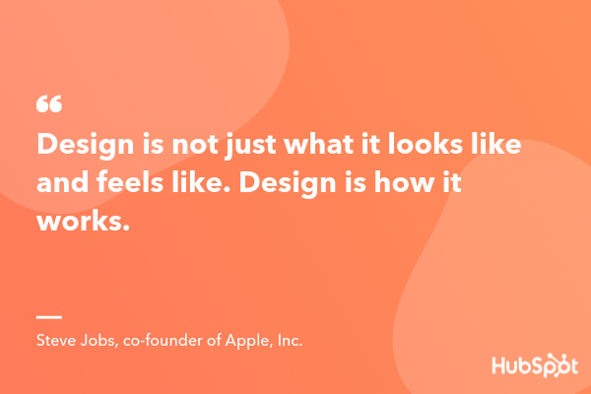

What is Design Technology?
'D&T' stand for Design and technology. D&T is a curriculum subject that teaches children about the design of a range of objects, how certain working parts ...

Slide 3
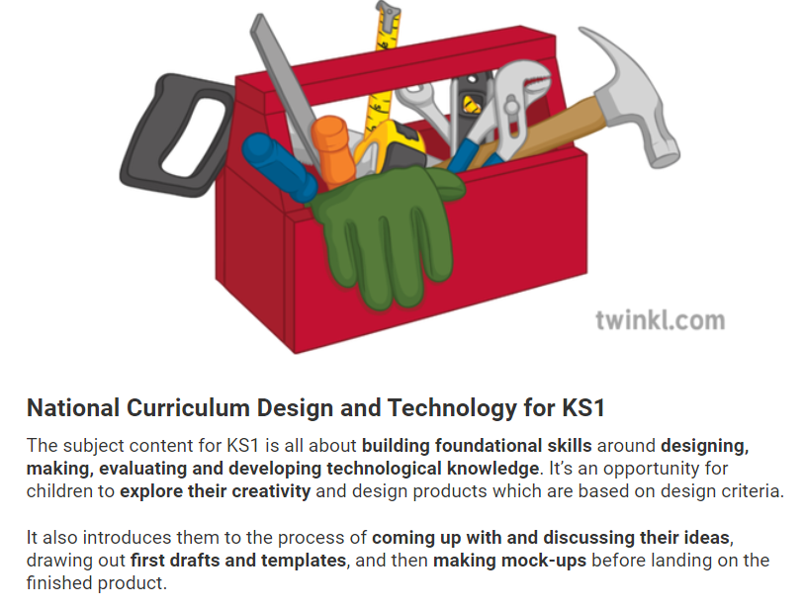

Slide 4
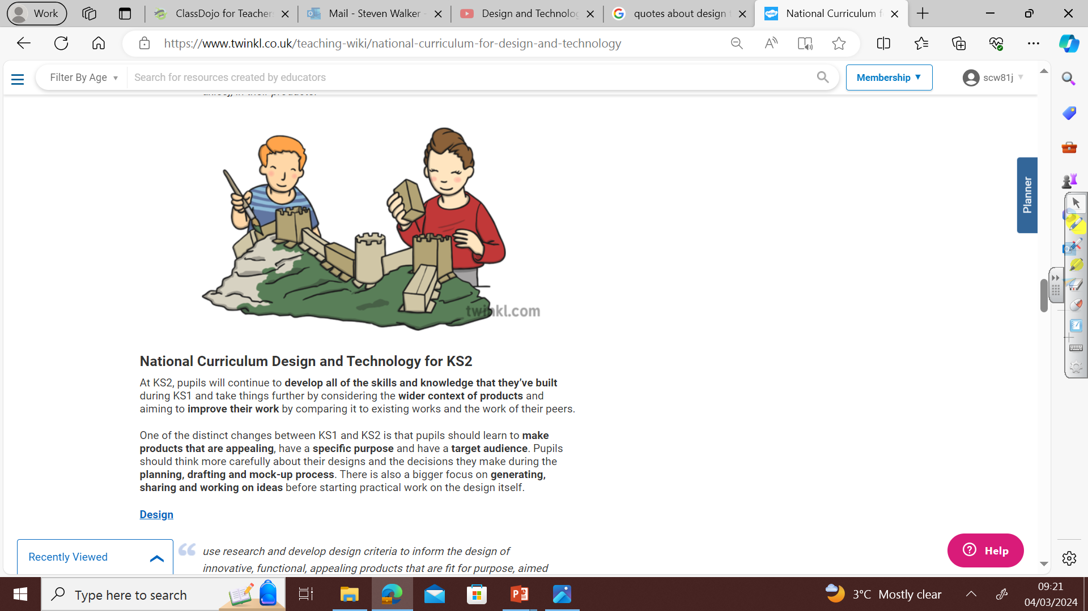

Slide 5
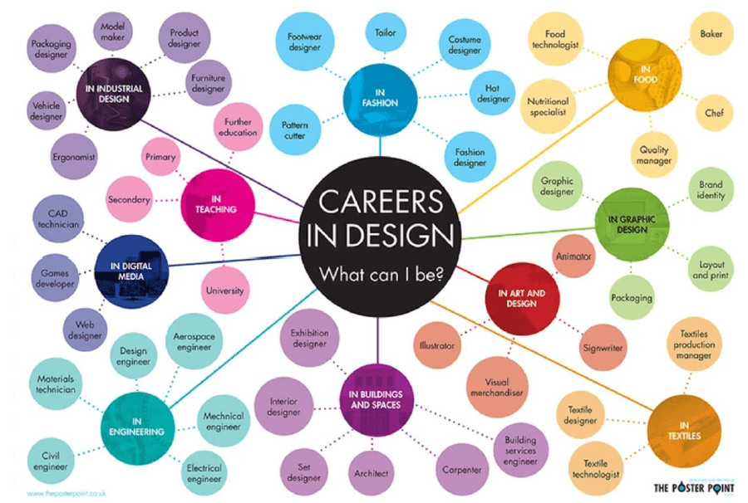
What jobs can DT lead too?

Slide 6
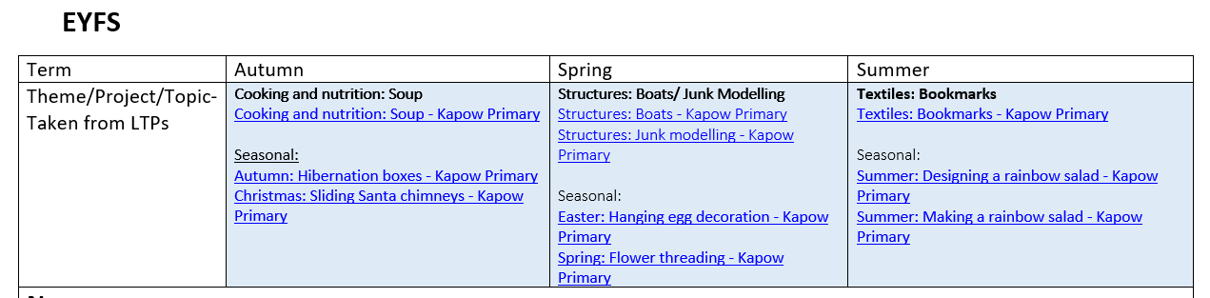
So, what projects do we do in our school?

Slide 7
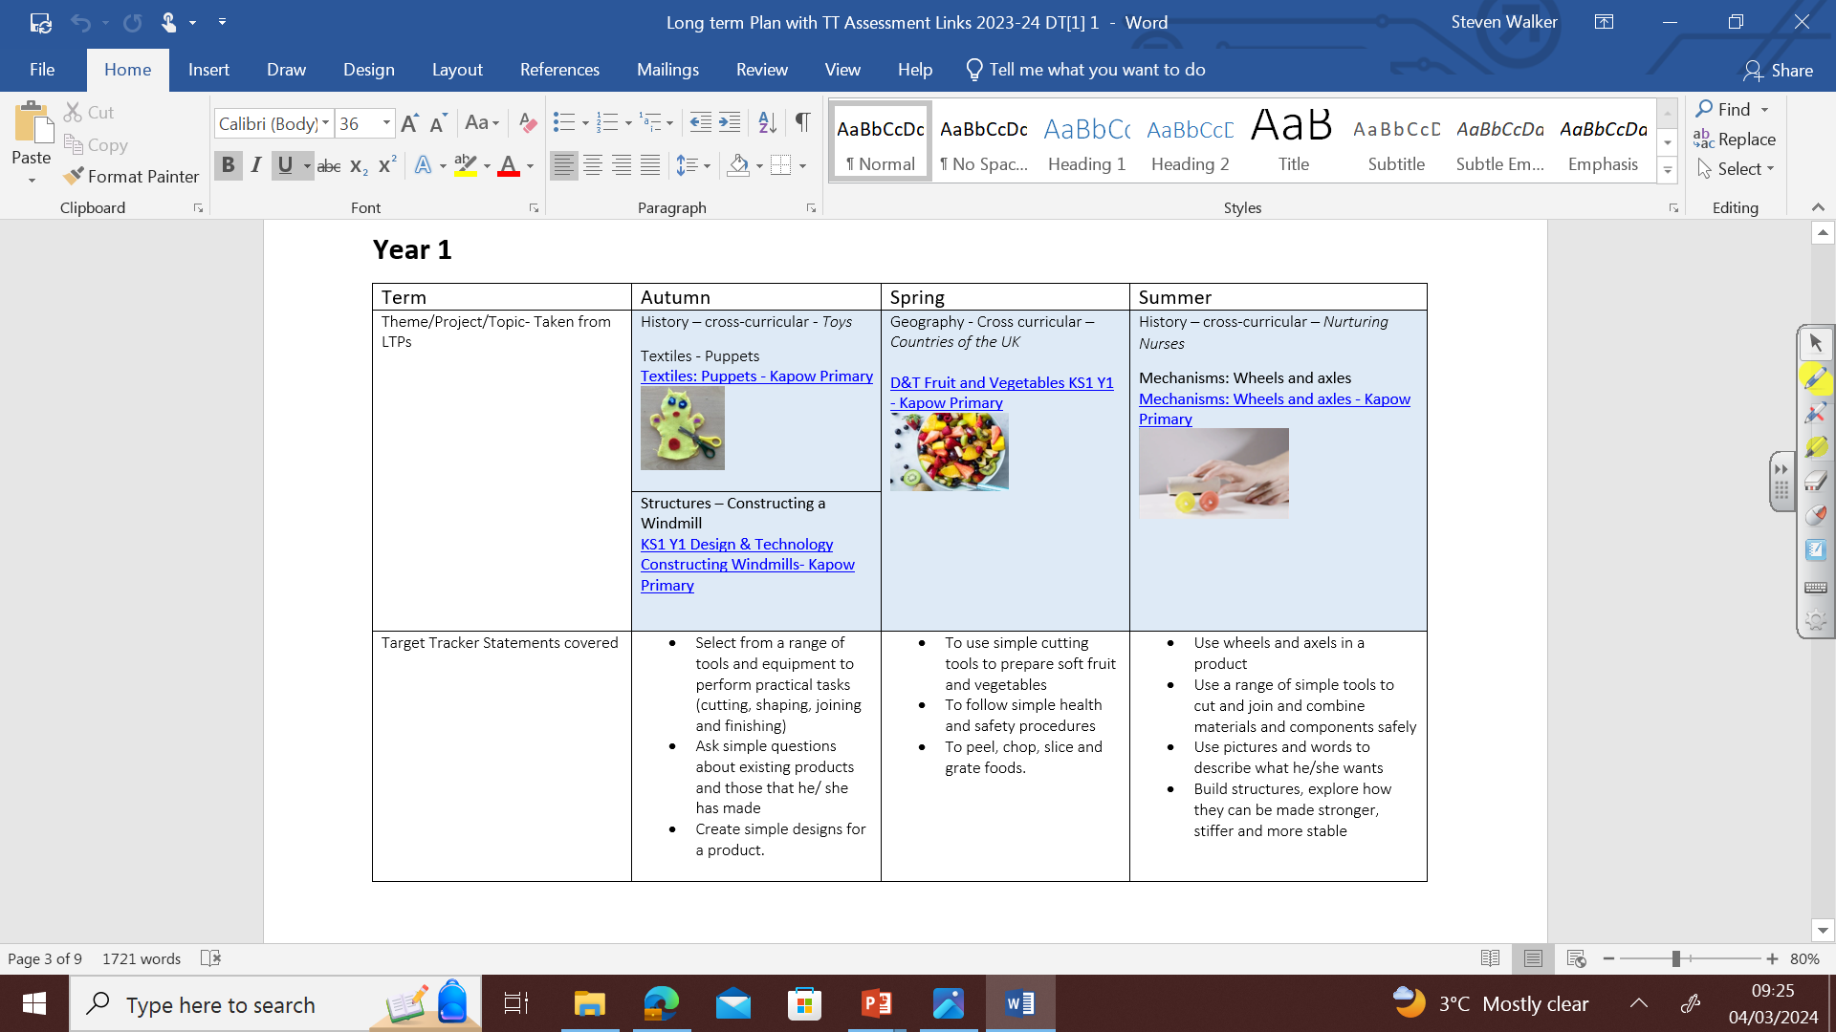
So, what projects do we do in our school?

Slide 8
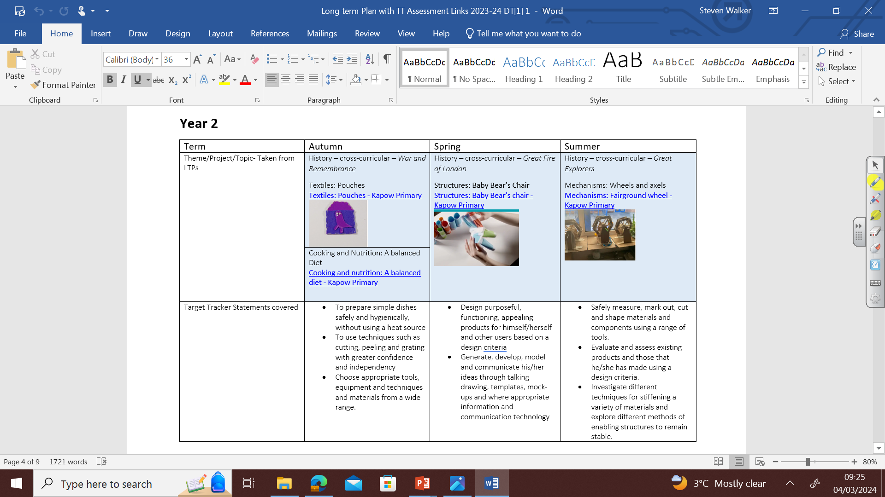

Slide 9
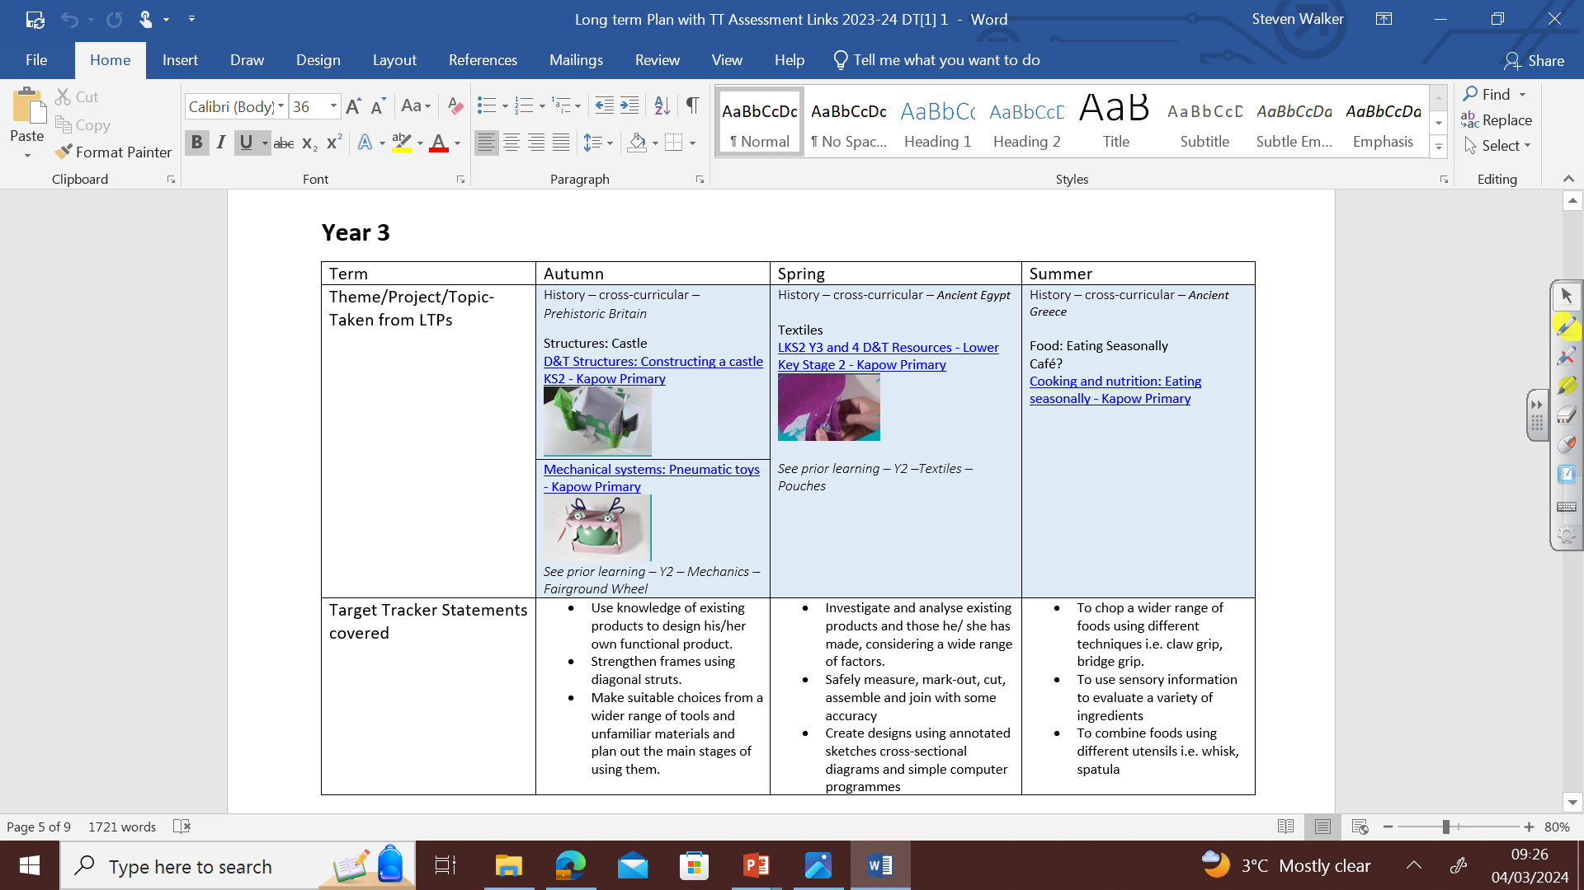

Slide 10
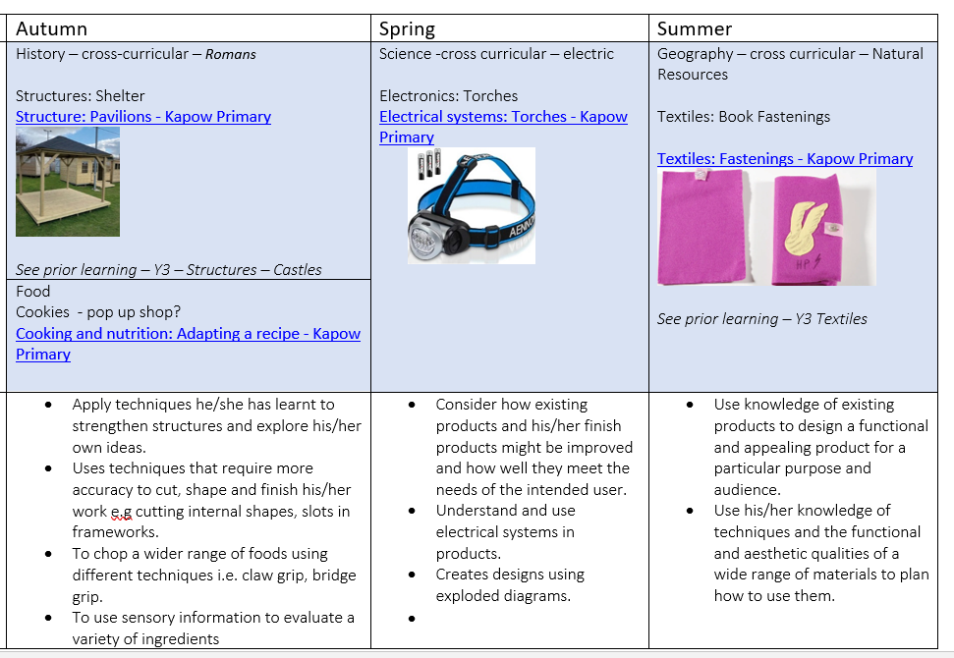

Slide 11
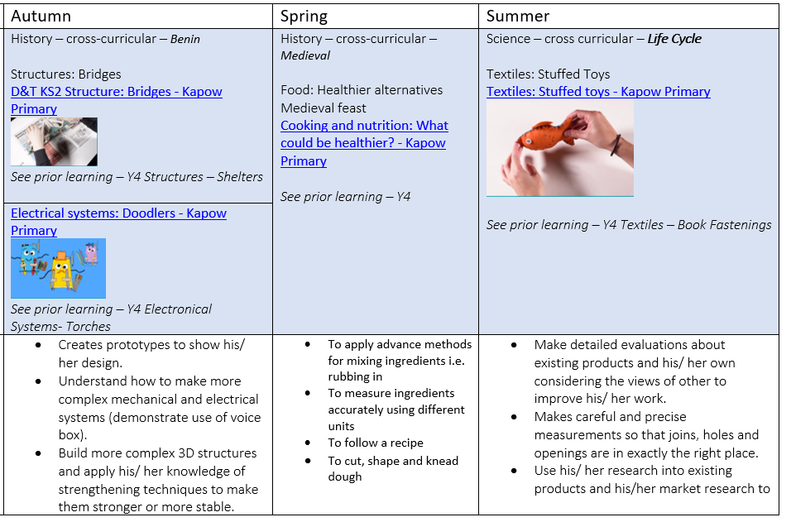

Slide 12
